Slide 1
4.4 Ito-Doeblin Formula(part2)
報告人：古豐上
張議文

Slide 2
The integral with respect to an Ito process
Ito-Doeblin formula for an Ito process
Example
→Generalized geometric Brownian motion
→Vasicek interest rate model
→Cox-Ingersoll-Ross(CIR) interest rate model

Slide 3

4.4.1
Ito-Doeblin formula for an Ito process

Slide 4

Def 4.4.5
Let , , be a Brownian motion ,
and let , , be an associated
filtration. An Ito process is a stochastic
process of the form
where is nonrandom , and and
are adapted stochastic processes.

Slide 5



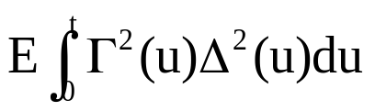
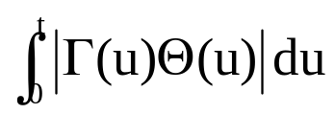

Def 4.4.5
Let , , be an Ito process as described in Definition 4.4.3, and let , , be an adapted process. We define the integral with respect to an Ito process
(We assume that and are finite for every so that the integrals on the right-hand side of (4.4.20) are defined.)
Notes:
4.4.3

Slide 6


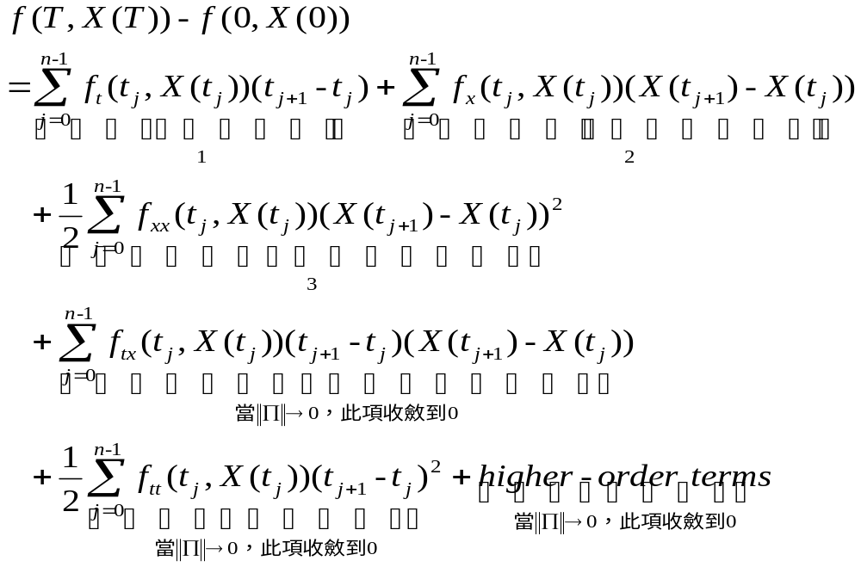
We again work through the sketch of the proof of Theorem 4.4.1, but with the Ito process replacing the Brownian motion . In place of (4.4.9), we now have

Slide 7





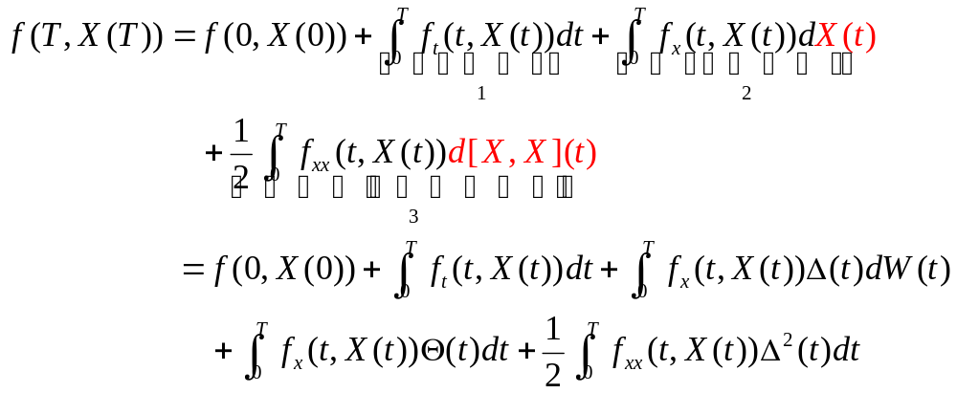
Thm 4.4.6 (Ito-Doeblin formula for an Ito process).
Let , , be an Ito process as described in Definition 4.4.3, and let be a function for which the partial derivatives , , and are defined and continuous. Then, for every ,

Slide 8

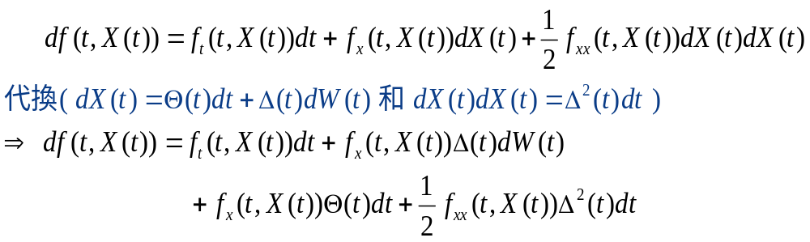
Remark 4.4.7(Summary of stochastic calculus).
Every term on the right-hand side has a solid definition and in the end the right-hand side reduces to a sum of a nonrandom quantity , three ordinary(Lebesgue) integrals with respect to time, and a Ito integral.

Slide 9





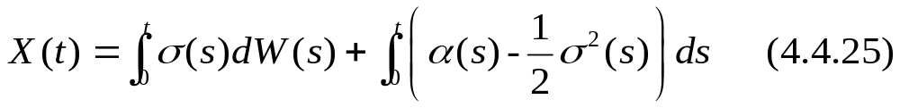
4.4.3 Examples
Example 4.4.8(Generalized geometric Brownian motion).
Let , , be a Brownian motion, let , , be an associated filtration, and let and be adapted processes.
Define Ito process

Slide 10
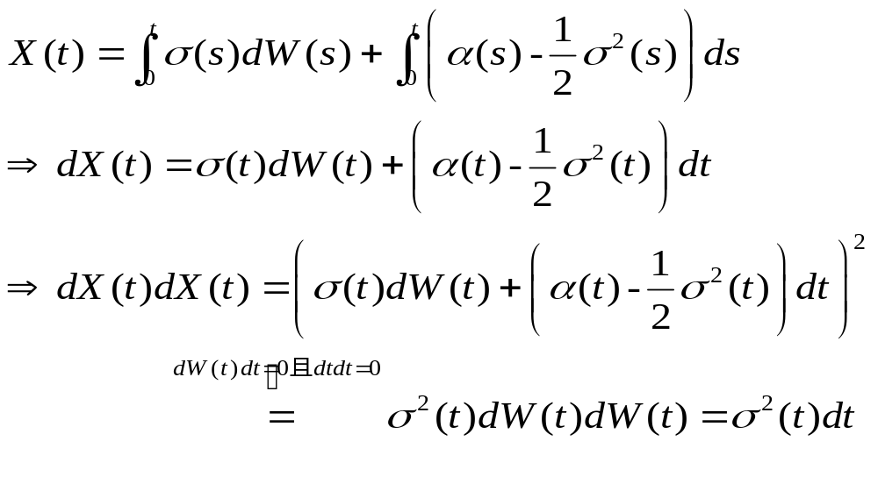

Slide 11
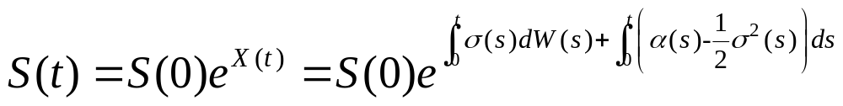


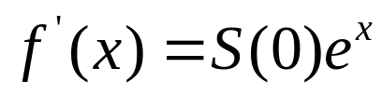
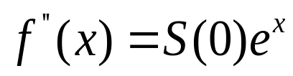
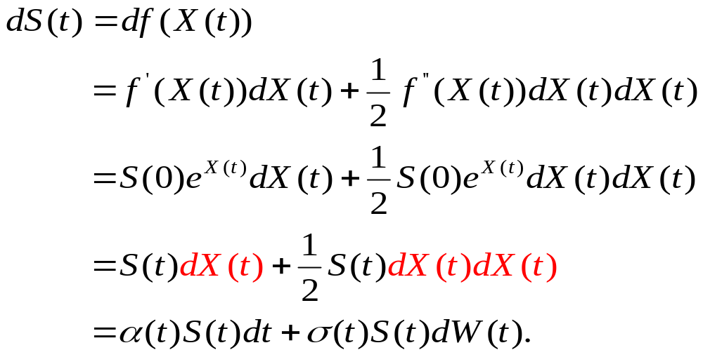
Consider an asset price process given by
Where S(0) is nonrandom and positive. We may write
,where , , and
. According to the Ito-Doeblin formula

Slide 12


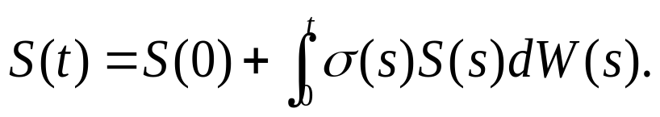
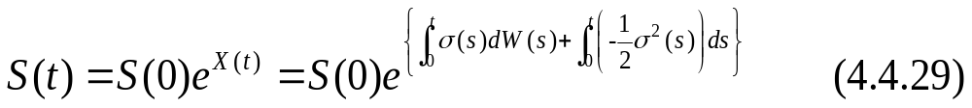
In the case ,
is a martingale, and hence (in the case )
is a martingale.

Slide 13



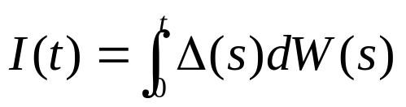

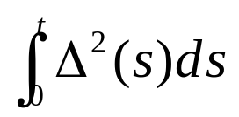
Thm 4.4.9(Ito integral of a deterministic integrand).
Let , , be a Brownian motion, and let be a nonrandom function of time. Define . For each , the random variable is normally distributed with expected value zero and variance .

Slide 14


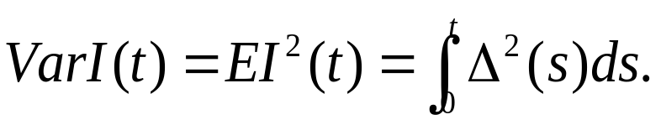
Proof Thm 4.4.9
1.determine the mean and variance of . Since
is a martingale and , we must
have . Ito’s isometry implies that
2.show that is normally distributed.

Slide 15
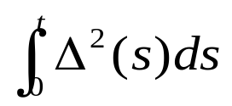
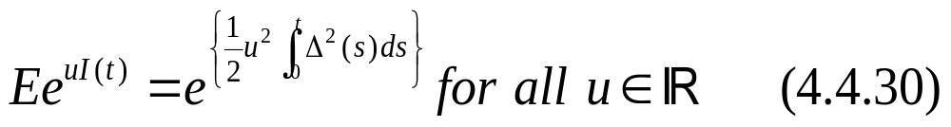

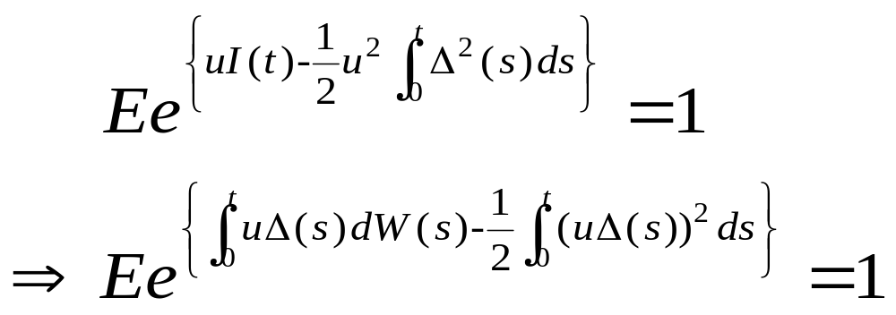
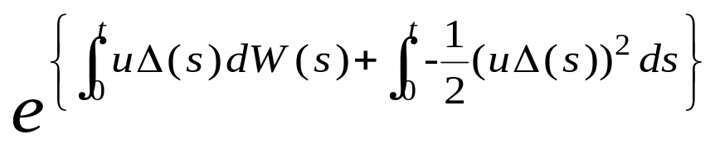
Establishing that has the m.g.f of a normal r.v. with mean zero and variance , which is
Because is not random, (4.4.30) is equivalent to
But the process
is a martingale(see(4.4.29)).

Slide 16




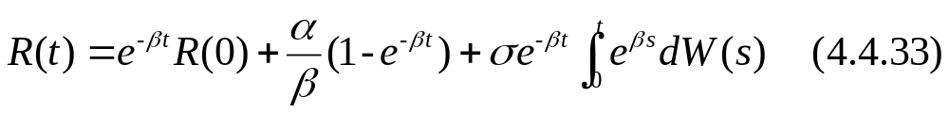
Example 4.4.10(Vasicek interest rate model).
Let , , be a Brownian motion. The Vasicek model for the interest rate process is
where , and are positive constants.
The solution to the stochastic differential equation (4.4.32) can be determine in closed form and is

Slide 17
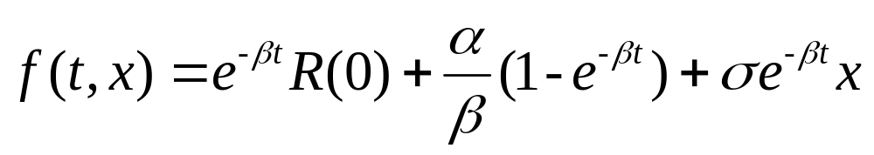
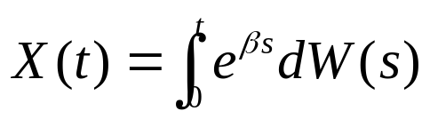
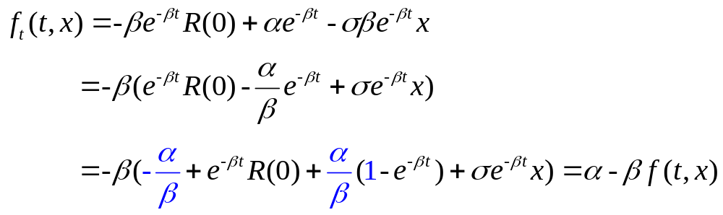
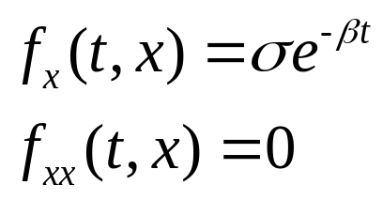
In particular, we compute the differential of the right-hand side of (4.4.33). To do this, we use the Ito-Doeblin formula with
and
so,

Slide 18
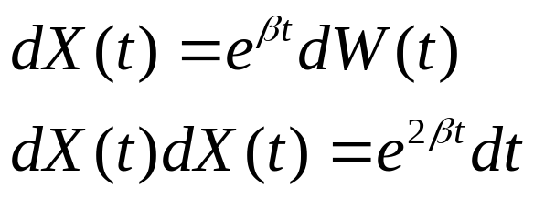
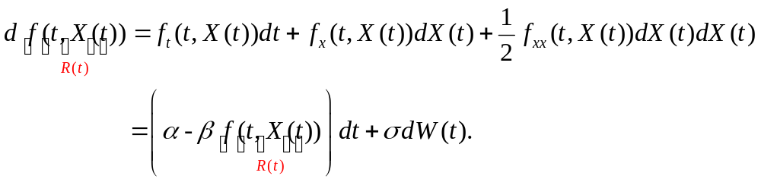
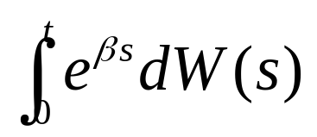
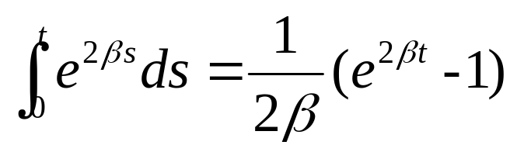
And ,
The Ito-Doeblin formula states that
Theorem 4.4.9 implies that the r.v. appearing
on the right-hand side of (4.4.33) Is normally distributed
with mean zero and variance

Slide 19
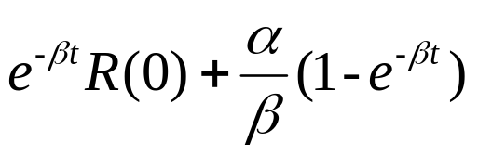
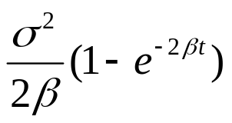



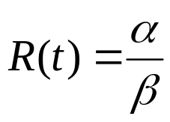
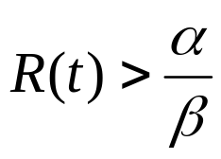

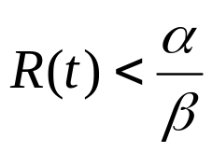
Therefore, is normally distributed with mean
and variance .
In particular, no matter how the parameters , and are chosen, there is positive probability that
is negative, an undesirable property for an interest rate model.
An desirable property that the interest rate : mean-
reverting. When , the drift term in (4.4.32) is zero.
When , this term is negative, which pushes
back toward . When , this term is
positive, which pushes back toward .

Slide 20


Example 4.4.10(Cox-Ingersoll-Ross(CIR) interest rate model).
Let , , be Brownian motion. The Cox-Ingersoll-Ross model for the interest rate process is
where , , and are positive constants. Unlike the Vasicek equation(4.4.32), the CIR equation (4.4.34) does not have a closed-form solution.
The interest rate in the CIR model does not become negative, If reaches zero, the term multiplying
vanishes and the positive drift term in equation (4.4.34) drives the interest rate back into positive territory.
Like the Vasicek model, the CIR model is mean-reverting.

Slide 21

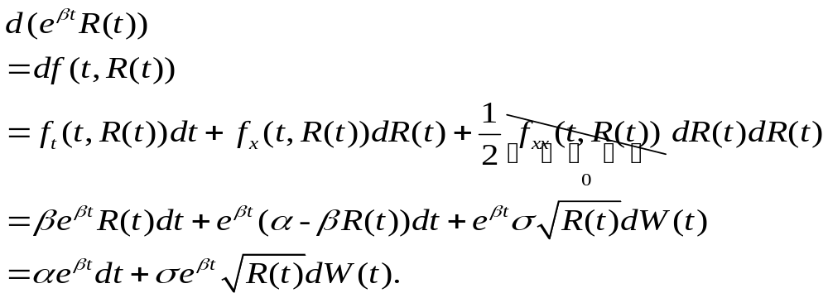
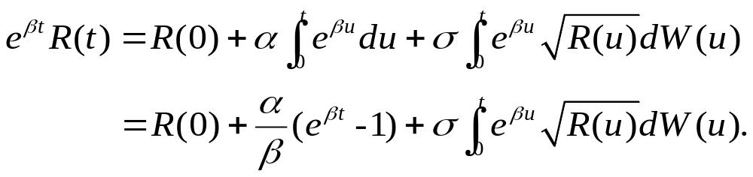
We instead content ourselves with the derivation of the expected value and variance of . To do this, we use the function and the Ito-Doeblin formula to compute
Integration of both sides of (4.4.35) yields

Slide 22
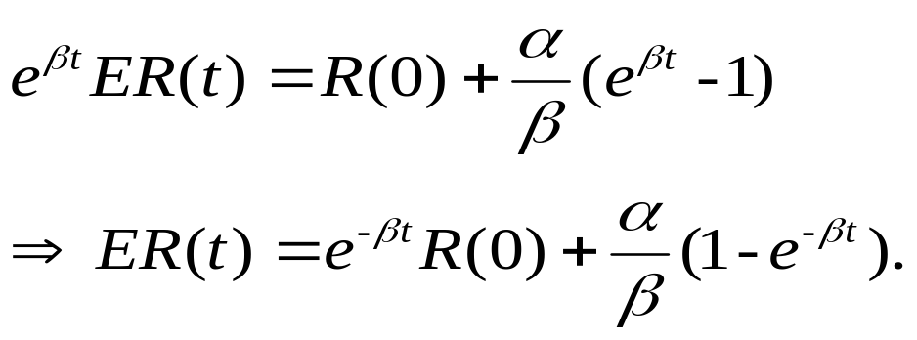


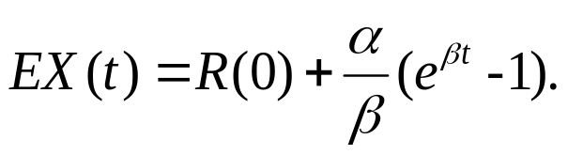
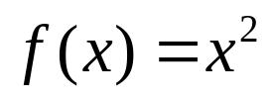


Recalling that the expectation of an Ito integral is zero, we obtain
To compute the variance of , we set
, for which we have already computed
and According to the Ito-Doeblin
formula (with , , and ),

Slide 23
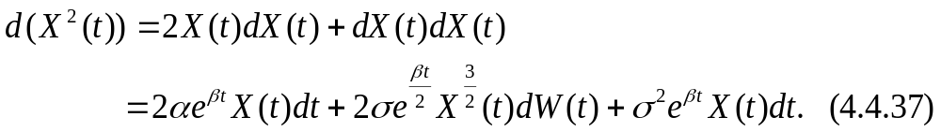
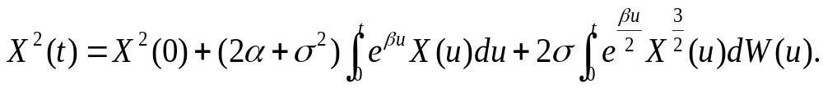

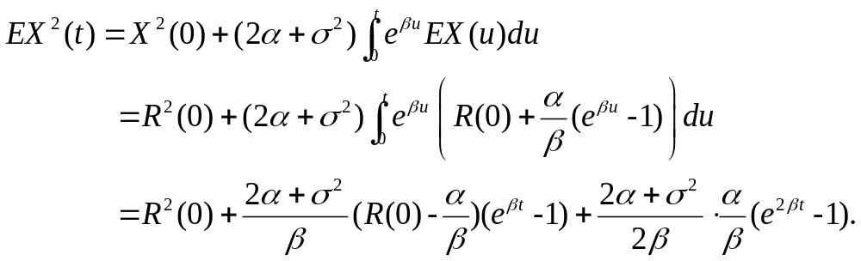
Integration of (4.4.37) yields
Taking expectations, using the fact that the expectation of
an Ito integral is zero and the formula already derived for
, we obtain

Slide 24
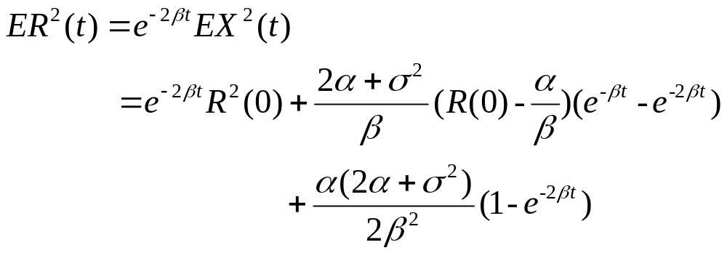
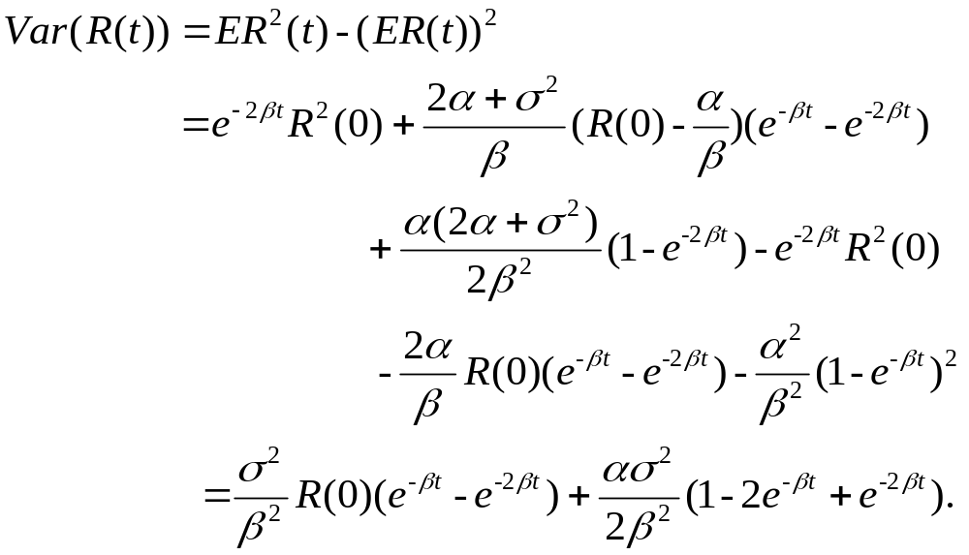
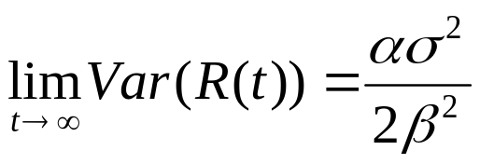
Therefore,
Finally,
In particular,

Slide 25
Thanks for your listening!!

